Slide 1


Department of Computer Science and Engineering
CA4: Mini Project
Data Science (0705210707)
Session: 2025-26
TITLE OF PROJECT - Market Price Analysis and Prediction Using Streamlit and Machine Learning
Presented By:
Name: Shaurya Potdukhe
PRN: 22070521011
Mentor:
Name: Dr. Piyush Chauhan
Designation: Associate Professor (Examination Incharge)
Department of Computer Science & Engineering
Symbiosis Institute of Technology, Nagpur Campus (SIT-N)

Slide 2
Problem Statement
The fluctuation in commodity prices over time affects both producers and consumers, making it crucial to understand and predict price trends. This project aims to analyze the commodity market price data from 2020 to 2025 using Exploratory Data Analysis (EDA) techniques to uncover key patterns, trends, and relationships, and to apply machine learning algorithms such as clustering and classification to identify commodity groups and predict high or low price categories. An interactive Streamlit dashboard is developed to visualize insights and enable real-time analysis.
The project aims to analyze and predict commodity price trends between 2020 and 2025 using data science techniques. Exploratory Data Analysis (EDA) is used to uncover patterns in pricing behavior, while clustering and classification algorithms help group commodities and predict price categories. The entire workflow is deployed as an interactive Streamlit dashboard for visualization and decision-making support.

Slide 3
Dataset Overview
• Dataset Name: Commodity Market Price (2020–2025)
• Source: https://www.data.gov.in/resource/variety-wise-daily-market-prices-data-commodity
• Time Period: 2020–2025
• Records: 100,000+ entries
Key Attributes:
• Market – Name of the market/mandi
• Commodity – Name of agricultural commodity
• Variety – Specific variety of the commodity
• Grade – Quality/grade classification
• Arrival_Date – Date of record
• Min_Price / Max_Price / Modal_Price – Price details in ₹
• Year – Extracted from Arrival_Date

Slide 4
Project Objectives
• To analyze commodity price fluctuations from 2020–2025.
• To perform Exploratory Data Analysis (EDA) for trend and pattern discovery.
• To group similar commodities using clustering algorithms (K-Means).
• To predict high or low price categories using classification models.
• To develop an interactive Streamlit dashboard for visualization.

Slide 5
Methodology
1. Data Collection – Dataset downloaded from data.gov.in.
2. Data Preprocessing – Handling missing values, formatting dates, and encoding categorical variables.
3. Exploratory Data Analysis (EDA) – Visualizing price trends, volatility, and market patterns.
4. Clustering – Applying K-Means to identify similar commodity groups.
5. Classification – Using Logistic Regression and Random Forest to classify commodities as High/Low price.
6. Dashboard – Building an interactive Streamlit web application for dynamic insights.

Slide 6
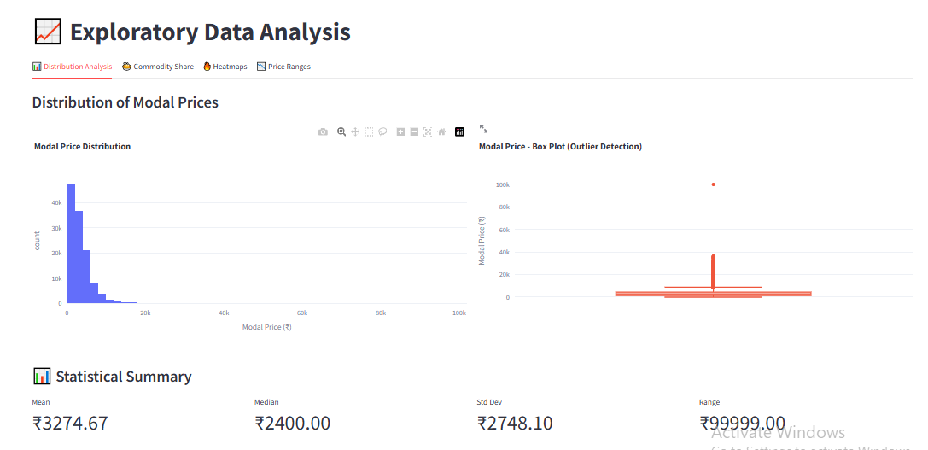
Exploratory Data Analysis (EDA)

Slide 7
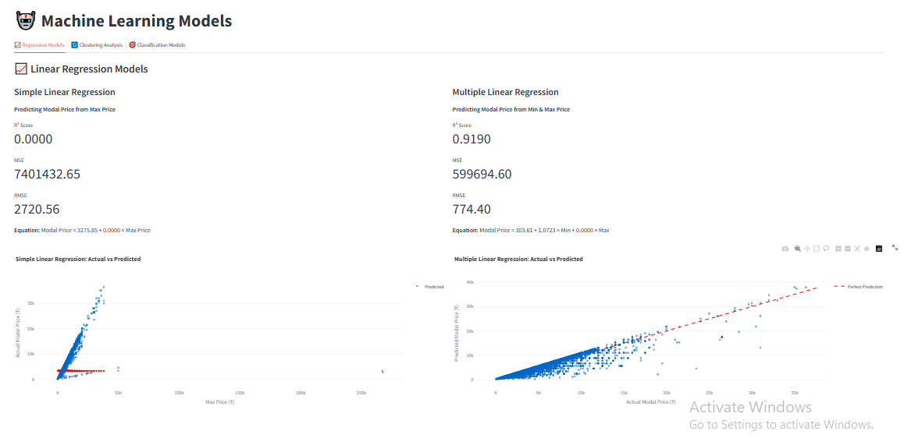
Simple and Multiple Linear Regression

Slide 8
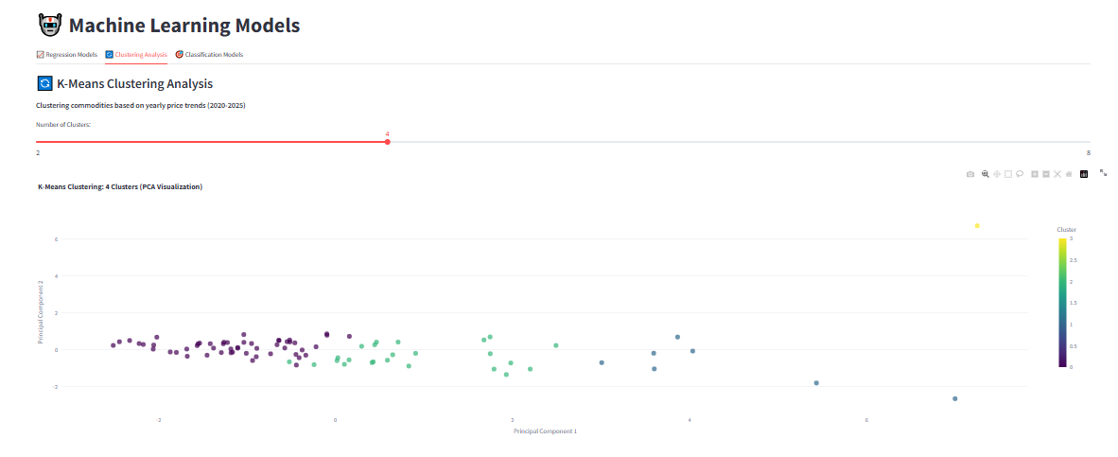
K-Means Clustering

Slide 9
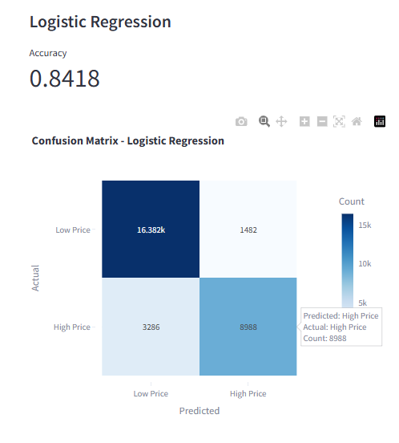
Logistic Regression

Slide 10
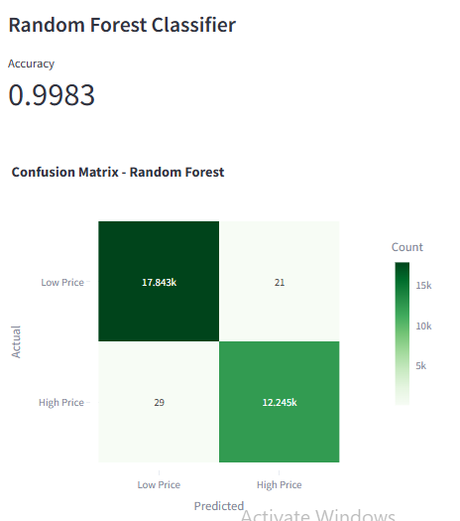
Random Forest Classifier

Slide 11
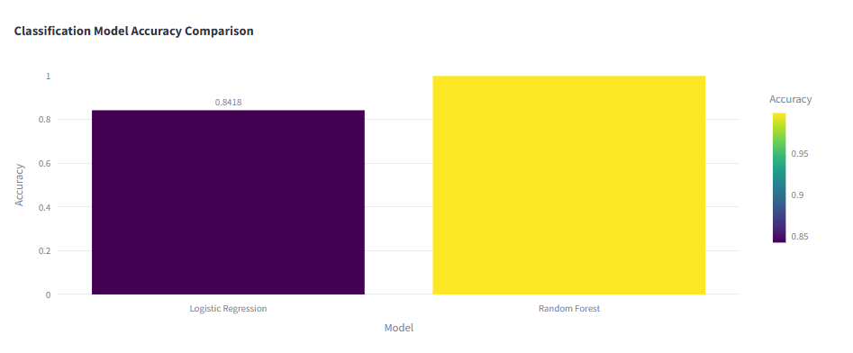
Model Comparison

Slide 12
Key Findings
• Significant variation observed in commodity prices between 2020–2025.
• Clustering grouped commodities based on similar yearly trends.
• Random Forest outperformed Logistic Regression in prediction accuracy.
• Price trends show seasonal dependencies and market-specific behavior.
• The Streamlit app simplifies real-time price analysis and visualization.

Slide 13
References
• Dataset - https://www.data.gov.in/resource/variety-wise-daily-market-prices-data-commodity
• Streamlit Documentation – https://streamlit.io
• Scikit-learn Library – https://scikit-learn.org
• Matplotlib & Seaborn Libraries
• Python Official Documentation – https://python.org

Slide 14
Thank You…..

